Slide 1
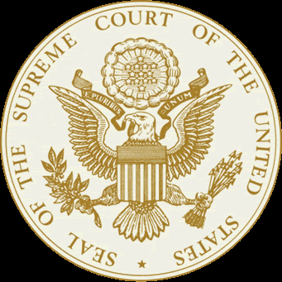
Landmark Supreme Court Cases

Slide 2
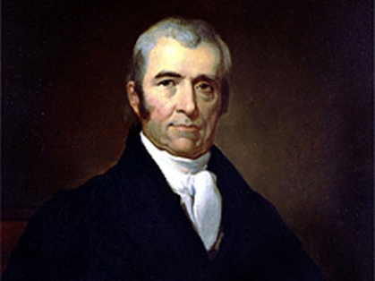
Marbury v. Madison
1803
Background Information
Before President John Adams was leaving the Presidency he appointed many new federal judges – like John Marshall as the new Chief Justice of the Supreme Court and William Marbury as a Justice of Peace for Washington, D.C. http://wn.com/marbury_v_madison - quimbee 4:27

Slide 3
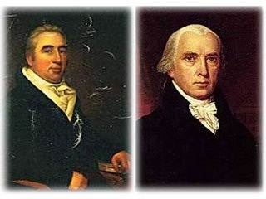
Marbury v. Madison
Not all of the judge appointments were finalized before the end of Adams presidency.
President Jefferson was sworn in and refused to deliver the remaining appointments - he felt they were no longer valid.
William Marbury sued Jefferson’s Secretary of State, James Madison to receive his appointment.

Slide 4
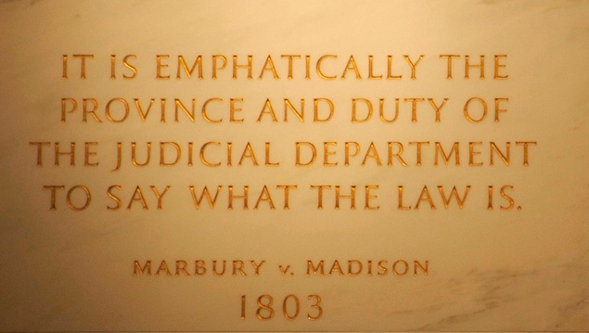
Marbury v. Madison
Supreme Court ruled in favor of Madison. Marbury did not receive his appointment – but even more important, the SC found the original law “unconstitutional”………
This case helped define the checks and balances system.
It established the Supreme Court’s power of judicial review.
Results

Slide 5
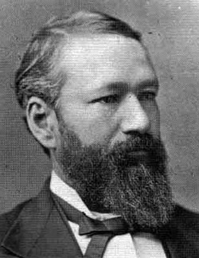
Plessy v. Ferguson
1896
Background Information
During this time, whites and blacks were required to ride in separate railway cars under Louisiana Law.
Although Homer Plessy was seven-eighths (7/8) white, he was required to ride the “colored” car.
Plessy was arrested for refusing to leave the “whites-only” car.
He took his case to state court because he felt segregation violated his Constitutional rights protected by the 14th Amendment.
The Louisiana judge, John Ferguson, ruled that Louisiana can enact segregation laws within the state.
The case was taken to the United States Supreme Court.

Slide 6
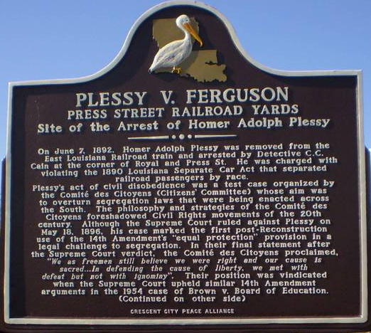
Plessy v. Ferguson
Results
The Supreme Court ruled in favor of Ferguson.
http://wn.com/plessy_vs_ferguson 1:24 clip
This decision upheld the separate-but-equal doctrine, that separate facilities for blacks and whites satisfied the Fourteenth (14th) Amendment as long as they were “equal”.

Slide 7
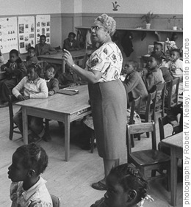
Brown v. Board of Education
1954
Background Information
In many areas, black children were NOT allowed to attend the same public schools as white children because laws permitted racial segregation.

Slide 8
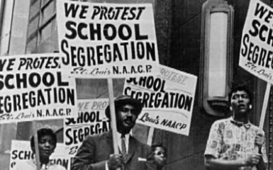
Brown v. Board of Education
Several parents of black children that were forced to be bused across town to a “black school”, including Oliver Brown, sued the Topeka School Board claiming racial segregation is unequal and violates the equal protection clause of the Fourteenth (14th) Amendment.
Lower courts agreed with the school system; the case was brought to the United States Supreme Court.

Slide 9
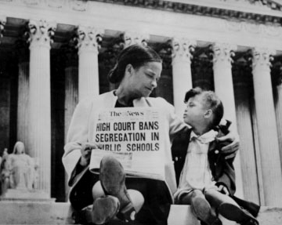
Brown v. Board of Education
Results
The Supreme Court ruled in favor of Brown with 9 votes.
The Supreme Court overturned Plessy v. Ferguson
Racial segregation in public education was now unconstitutional. (separate is inherently unequal – which is unconstitutional)

Slide 10
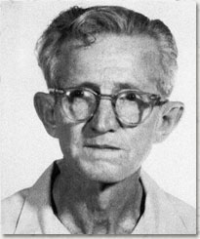
Gideon v. Wainwright
1962
Background Information
Clarence Gideon was arrested and charged in a Florida court for breaking and entering. He stole change from a Pool Hall…….
He was unable to afford a lawyer and the court refused to appoint a free lawyer.

Slide 11
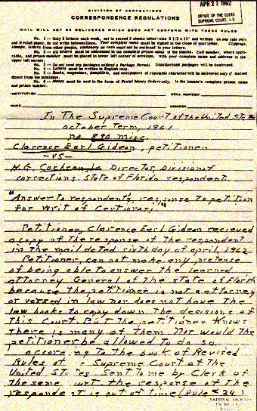
Gideon v. Wainwright
Gideon was forced to defend himself in court and the jury found him guilty.
He finally got help and appealed the court’s decision all the way up to the United States Supreme Court. He claimed that they had violated his rights under 6th and 14th Amendment. (attorney and equal protection)

Slide 12
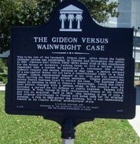
Gideon v. Wainwright
Results
The Supreme Court ruled in favor of Gideon with 9 votes.
The Supreme Court held that Gideon and other defendants in criminal cases that could not afford legal counsel do have the right to a court-appointed lawyer.

Slide 13
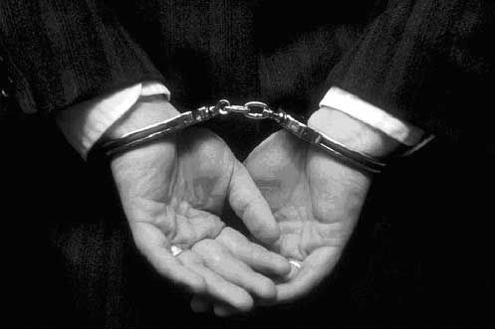
Miranda v. Arizona
1966
Background Information
Arizona arrested Ernesto Miranda for kidnapping. The state court found him guilty.
He was questioned without being advised of his right to remain silent, his right to consult with an attorney or any of his other legal rights.

Slide 14
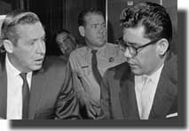
Miranda v. Arizona
Miranda’s attorney appealed his conviction to the Supreme Court claiming the police violated his rights under the 5th Amendment (self-incrimination).

Slide 15
Miranda v. Arizona
Results
The Supreme Court ruled in favor of Miranda with five votes.
The decision held that the police cannot question a person in custody unless they have been read their legal rights.
1. The right to remain silent
2. The right to an attorney (at government expense if the accused is unable to pay)
3. The fact that anything the person says after stating that he or she understands these rights can be used as evidence in court.

Slide 16
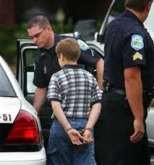
In Re Gault
1966
Background Information
At the age of 15, Gerald Gault was arrested for making an extremely indecent phone call.
Gerald Gault was denied the right to due process because he was a juvenile.
Gault was tried in juvenile court and sentenced 6 years in the juvenile detention.
The case was taken to the Supreme Court.

Slide 17
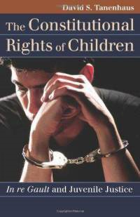
In Re Gault
Results
The Supreme Court ruled in favor of Gault.
They ruled that the proceedings of the Juvenile Court were unconstitutional because he did not receive due process.
Criminal cases for juveniles must obey the 14th Amendment.
Minors have the same rights as adults. (except for no jury trial!)

Slide 18
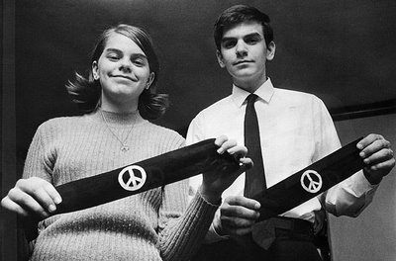
Tinker v. Des Moines
School District
1968
Background Information
John Tinker, his sister Mary Beth Tinker, and other students decided to wear black armbands to school in protest of the Vietnam War.
The school had a policy prohibiting any protest of the War.

Slide 19
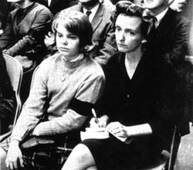
Tinker v. Des Moines
School District
When the students arrived to school, they refused to remove their armbands and were suspended.
They claimed the school officials violated their 1st Amendment rights.

Slide 20
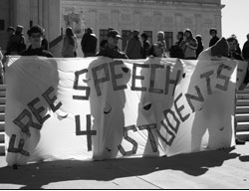
Tinker v. Des Moines
School District
Results
The Supreme Court ruled in favor of the Tinker children.
The Court said that students were allowed to wear armbands because it is protected by the 1st Amendment – freedom of expression (freedom of speech)
“Students do NOT shed their rights as they enter the school house gates”

Slide 21
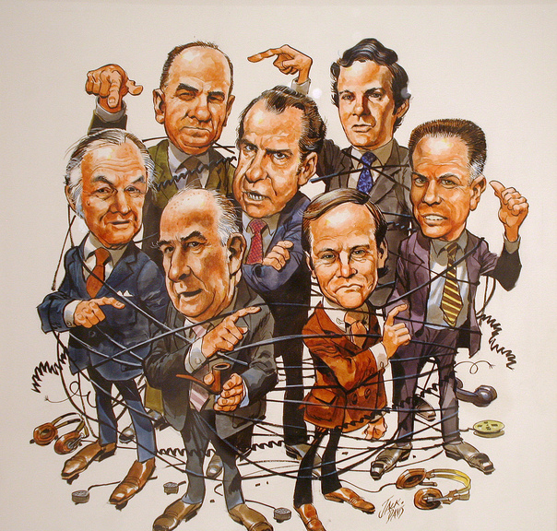
United States v. Nixon
1974
Background Information
BrainPop – Nixon (minute 4)
In 1972, the office of the Democratic Party in Washington D.C. at the Watergate Hotel was broken into.
During the criminal investigation, a federal judge ordered President Nixon (republican) to turn over audio tapes of conversations recorded by Nixon in the Oval Office of the White House.

Slide 22
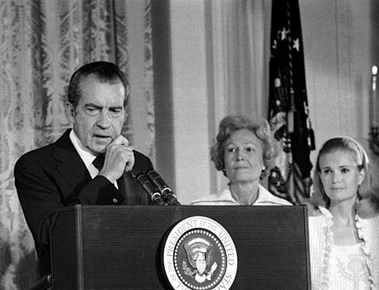
United States v. Nixon
Nixon refused to turn over the tapes and claimed “executive privilege” allowed him to withhold the conversation tapes from the other government branches and preserve confidentiality.

Slide 23
United States v. Nixon
Results
This case went to the Supreme Court who ruled in favor of the United States with eight votes.
The decision in this case made it clear that the president is NOT above the law. (rule of law)
Nixon was required to turn over the tapes which revealed evidence linking the President to the conspiracy to obstruct justice and cover up the break in at the Watergate Hotel.
President Nixon resigned shortly after.

Slide 24

Hazelwood School
District v. Kuhlmeier
1987
Background Information
Students of Hazelwood East High School wrote and edited the school-sponsored newspaper.
The school principal removed two articles from the issue and claimed they were inappropriate.

Slide 25
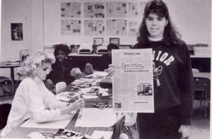
Hazelwood School
District v. Kuhlmeier
Cathy Kuhlmeier and two other students brought the case to court because they believed the principal violated their 1st Amendment rights. (freedom of the press)

Slide 26

Hazelwood School
District v. Kuhlmeier
Results
The Supreme Court ruled in favor of Hazelwood School District with five votes
The Supreme Court ruled that school officials have the right to censor articles in the student newspaper or limit speech that interferes with the school’s educational mission.

Slide 27
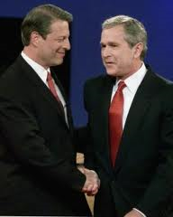
Bush v. Gore
2000
Background Information
During the 2000 presidential election, Al Gore (D) and George W. Bush (R) were extremely close in their number of votes on election day. All votes were in and the election came down to who would win Florida. The state of Florida had many issues with voting and Al Gore requested that Florida manually recount the disputed votes.

Slide 28
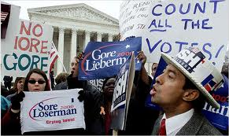
Bush v. Gore
These votes would determine which candidate won Florida’s electoral votes and would ultimately win the election.
Bush requested to stop the recount and claimed it violated the 14th Amendment. (equal protection)

Slide 29
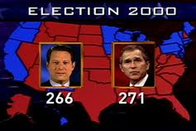
Bush v. Gore
Results
The case went to the Supreme Court – the Court ruled in a 7-2 vote in favor of Bush that the Florida recount was unconstitutional.
The Supreme Court ruled the recount must be stopped because the manual recount had no uniform way (different from county to county) to judge each disputed vote equally, which violated the Constitution’s Equal Protection Clause (14th Amendment).
As a result of the US Supreme Court’s finding, George W. Bush won in Florida and therefore won the presidential election.

Slide 30
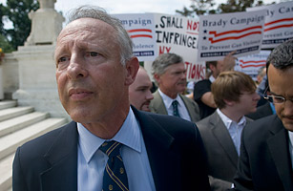
District of Columbia v. Heller
2007
Background Information
After the District of Columbia passed a law requiring the registration of handguns, requiring licenses for all pistols, and mandating that all legal firearms must be kept unloaded and disassembled or trigger locked, a group of private gun-owners (including Heller) brought suit claiming the laws violated their 2nd Amendment right to bear arms.

Slide 31
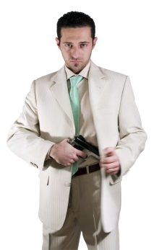
District of Columbia v. Heller
2007
Background Information
The federal court that heard the case first said the Second Amendment only protected ownership of firearms for those associated with a militia, like the National Guard.
The Court of Appeals, who heard the case next, voted 2-1 in favor of protecting private ownership.
D.C. appealed the case to the United States Supreme Court.

Slide 32

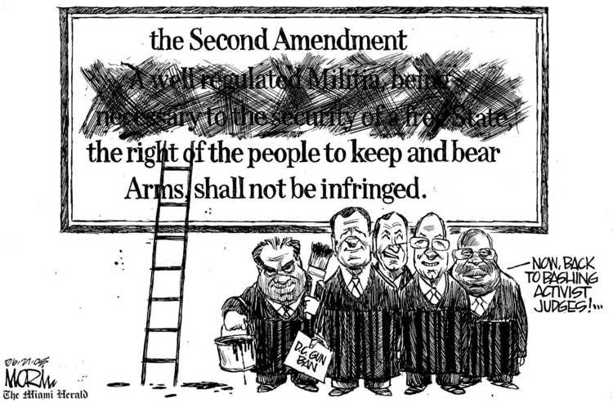
District of Columbia v. Heller
Results
The Supreme Court ruled in favor of Heller with five votes
The Court held that the Second Amendment does protect an individual right to possess a firearm unconnected with service in a militia, and to use that firearm for traditionally lawful purposes, such as self- defense within the home.
http://wn.com/dc_v_heller

